Slide 1
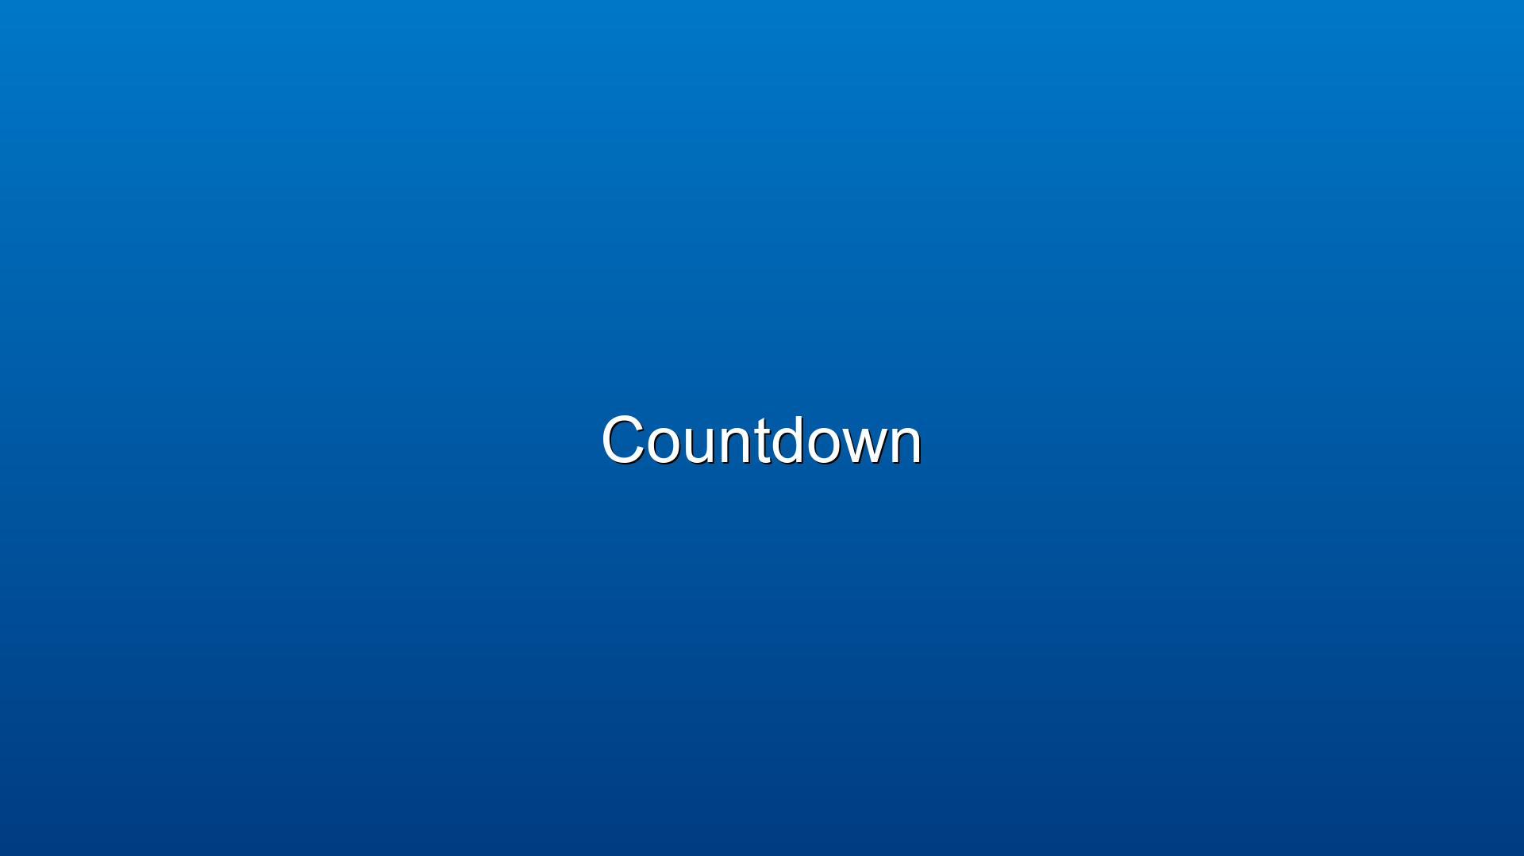


Slide 2
Opening Praise

Slide 3
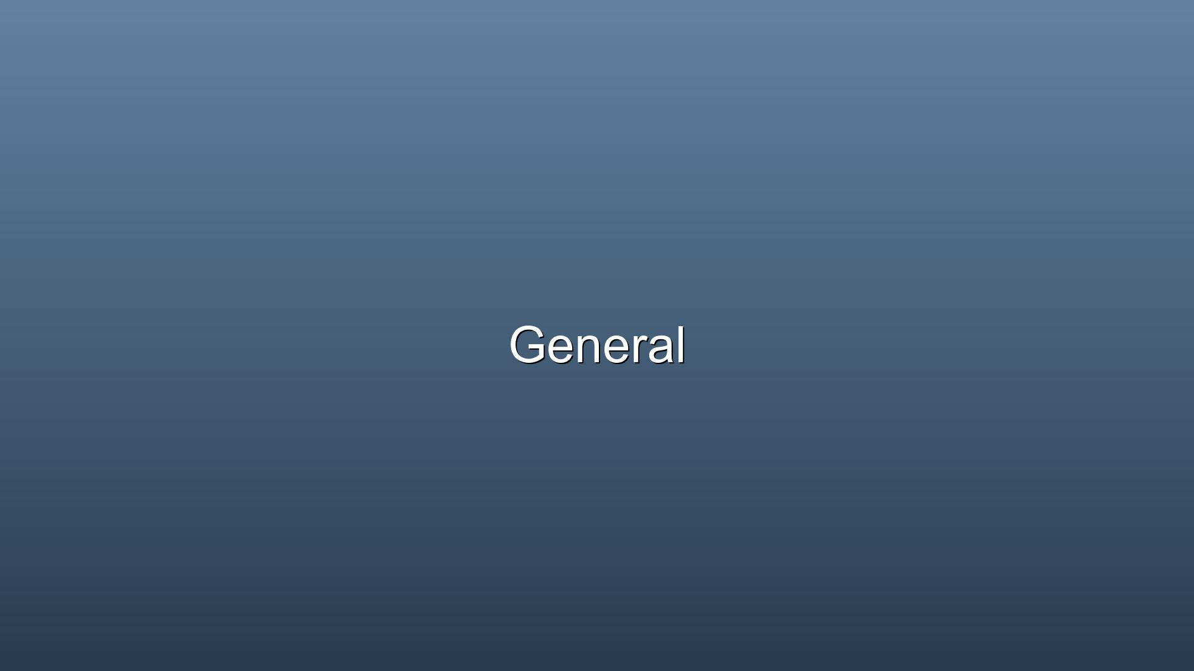
Announcements

Slide 4
Children’s Message
Pastor Megan

Slide 5
Call to Worship
Come to the water, all you who thirst, come drink deeply from the river of life...

Slide 6
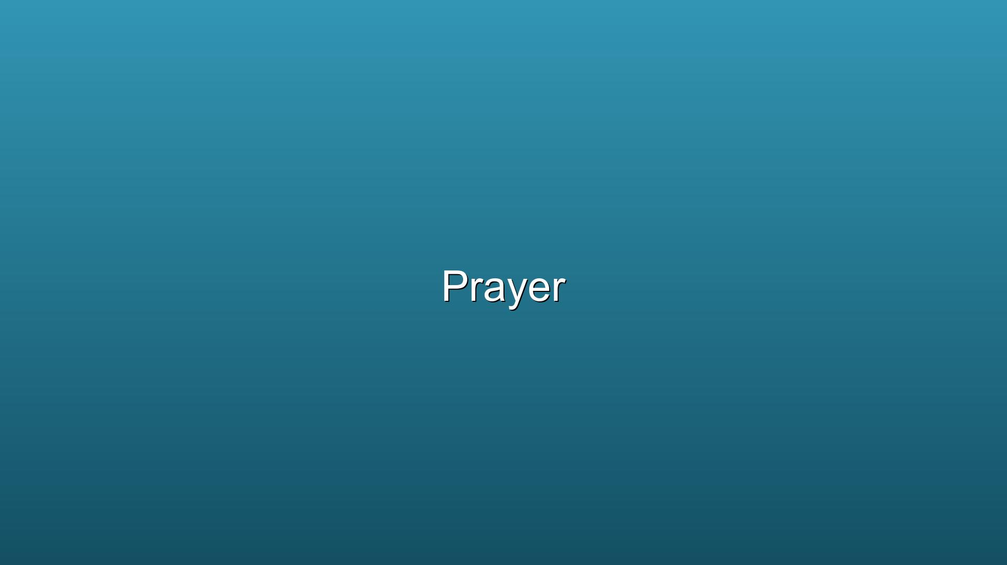
Opening Prayer
Almighty Creator, Lord of heaven and earth, we thank you for the gift of water...

Slide 7
Hymn of Praise

Slide 8
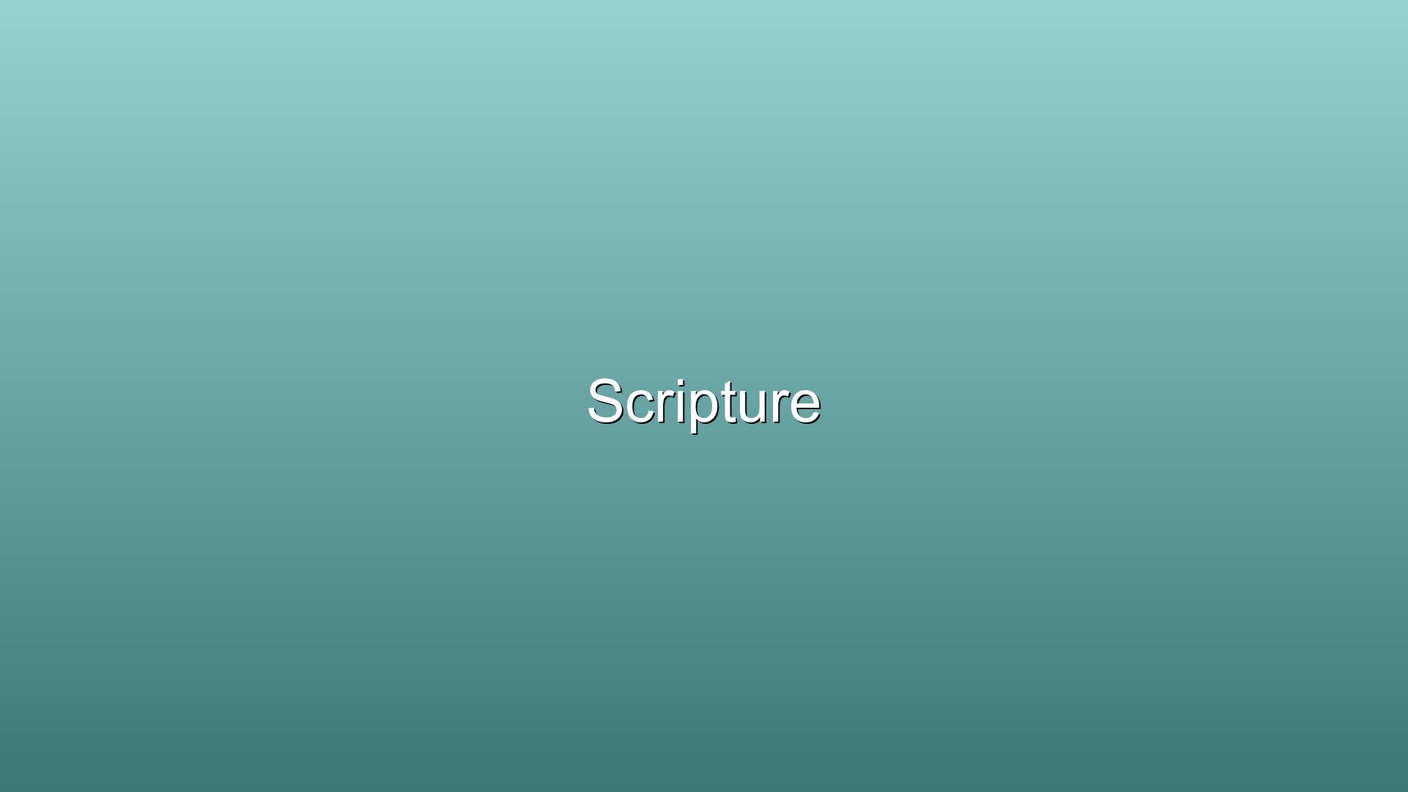
15 Then the Lord said to Moses, “Why are you crying out to me? ...

Slide 9
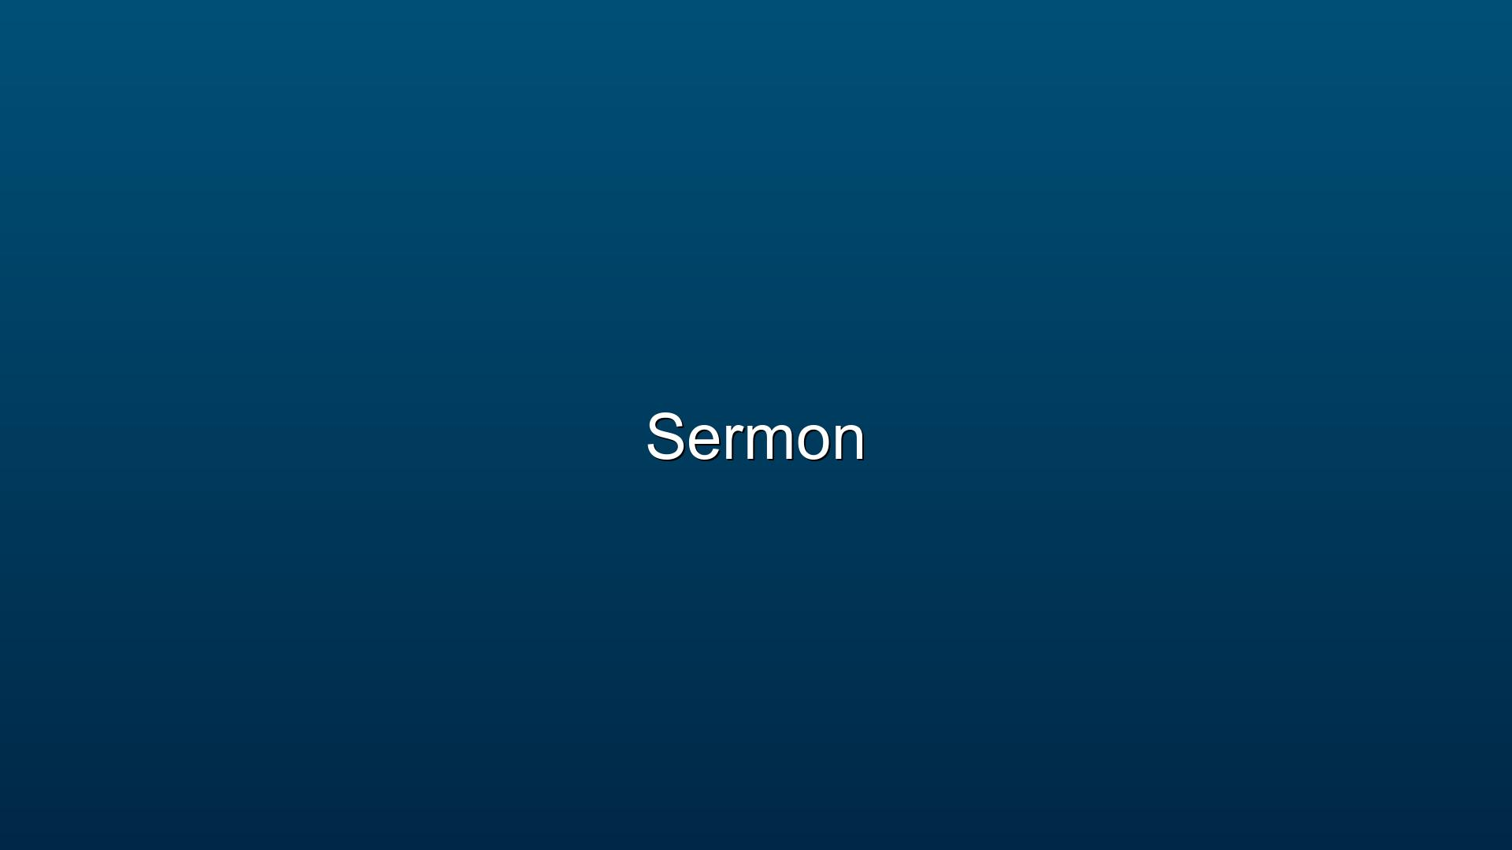
Sermon
Moses and the Red Sea
Pastor Megan

Slide 10
Holy Communion

Slide 11
Lord’s Prayer

Slide 12
Prayers for the Community

Slide 13
Offering with Doxology

Slide 14
Closing Praise

Slide 15
Dismissal

